Slide 1
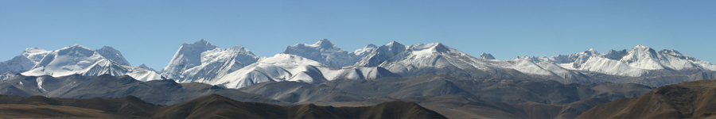
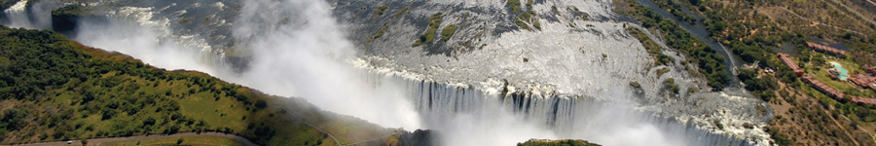
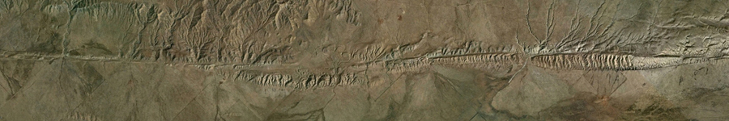
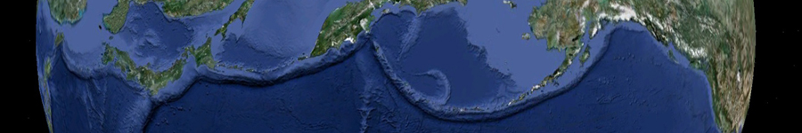
PLATE TECTONICS

Slide 2
Theory of plate tectonics:
The outer layer of the Earth (lithosphere) consists of separate plates that move with respect to one another
1960’s: relatively new concept!
“Grand unifying theory” of geology
Earthquakes - Mountain building
Paleontology - Faulting/rifting
Volcanism - Life!!!
Distribution of resources!
Notes:
Geology happens where plates interact along divergent, transform, and convergent boundaries.
First accepted global theory to explain major features of earth
Kinematic theory – doesn’t explain driving mechanisms – that is mantle convection theory

Slide 3
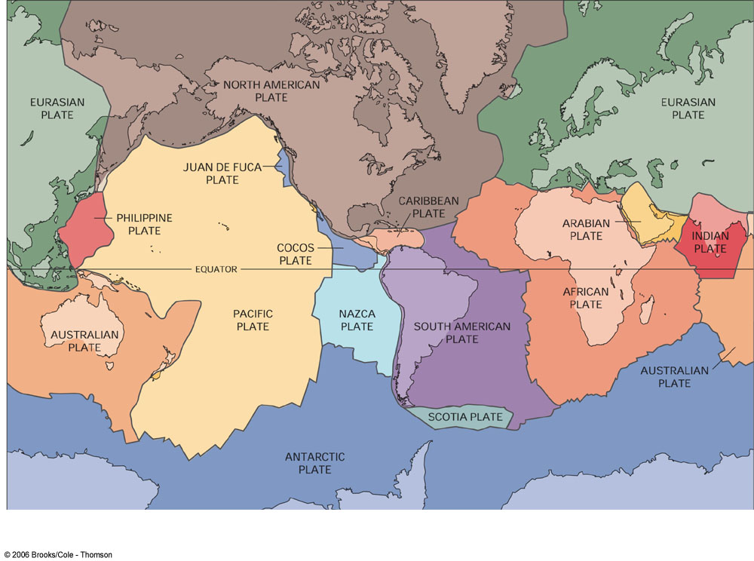
Key Points
Lithosphere broken up into 12 major and many minor plates
→ move/glide over weak asthenosphere.
Plate boundaries do not necessarily correspond to edge of continent
Plates move relative to one another
Minimal deformation in interior of plates.

Slide 4
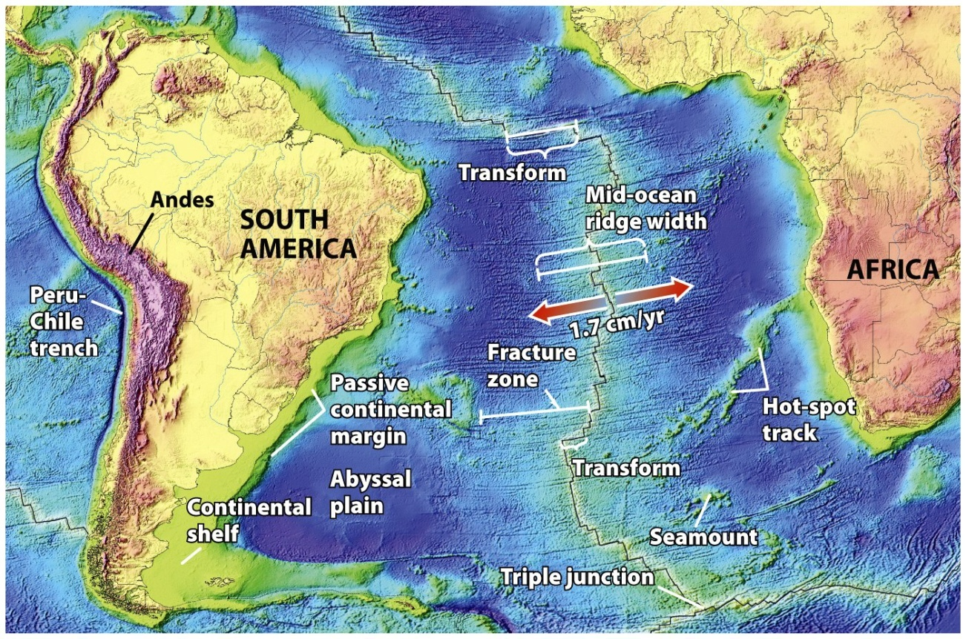
Active
Margin
Passive margin – no subduction

Slide 5
Three Types of Plate Boundaries

Slide 6
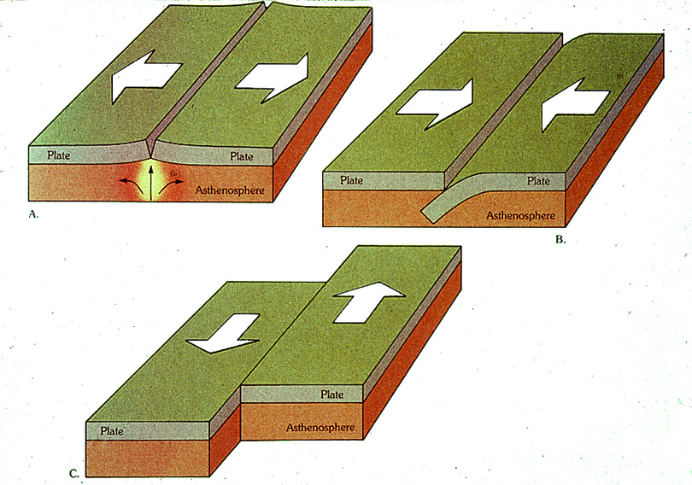
Divergent
Convergent
Transform

Slide 7
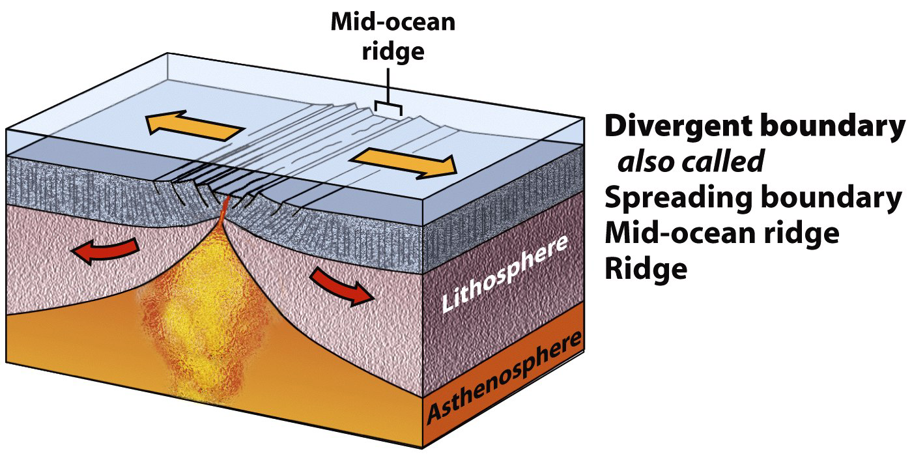
Plate Boundaries
Divergent – plates move apart.
Lithosphere thickens away from the ridge axis.

Slide 8
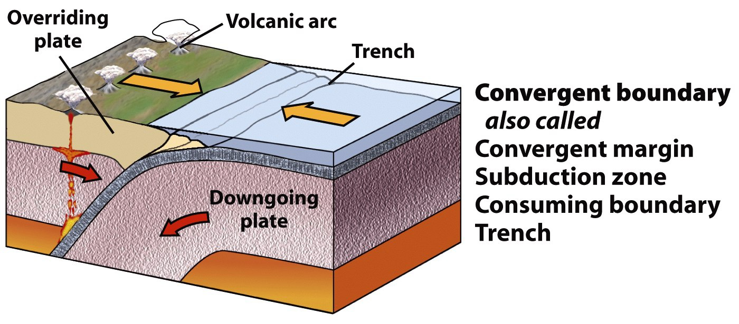
Plate Boundaries
Convergent – plates move together.
Process of plate consumption = subduction

Slide 9
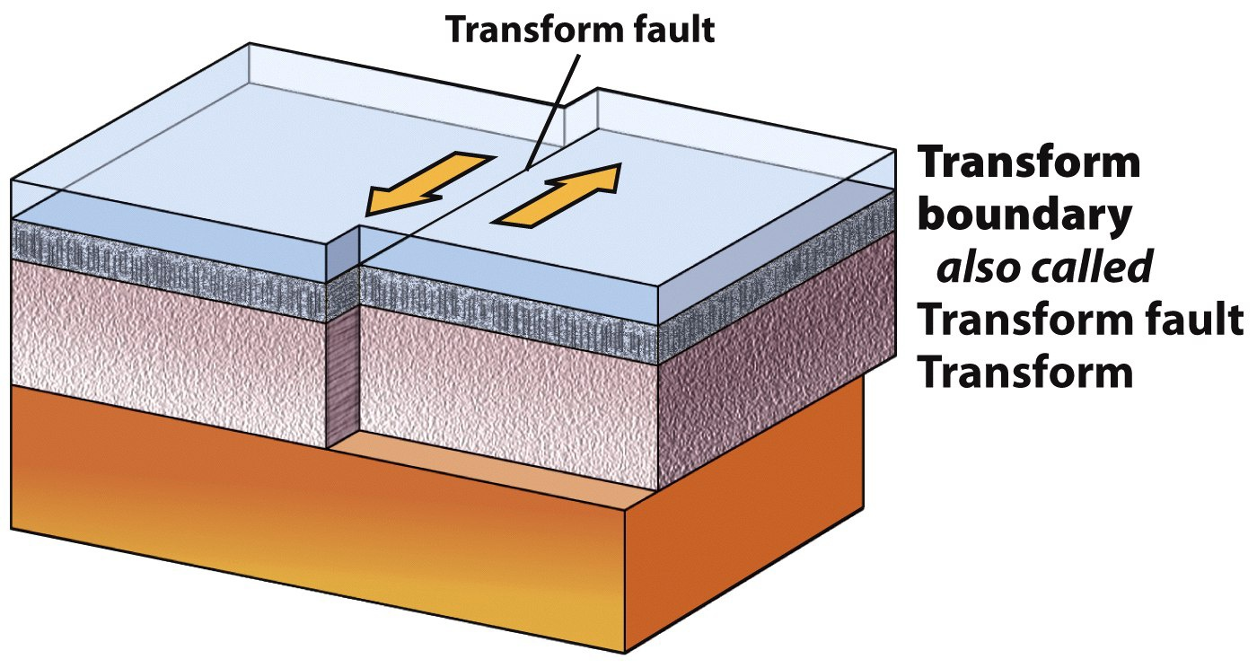
Plate Boundaries
Transform – plates slide against each other.
Neither creation nor destruction of lithosphere.

Slide 10
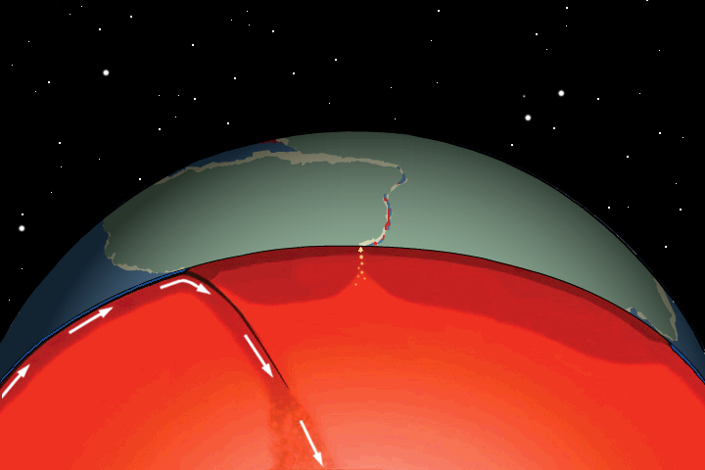
Divergent Plate Boundaries
Sea-floor spreading pulls plates apart
Magma wells up to fill gap and cools
Courtesy of Tanya Atwater
Notes:
Not only does new oceanic crust form at the mid ocean ridge, but old oceanic crust is destroyed at trenches

Slide 11
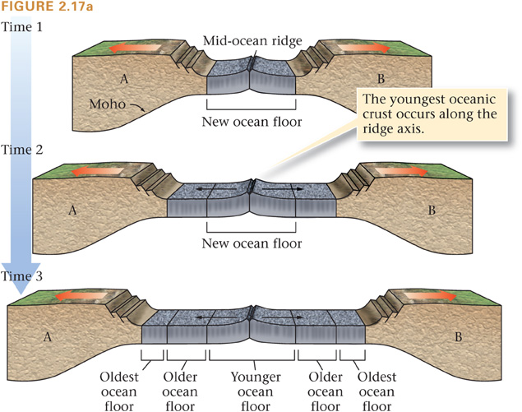
Notes:
Like a conveyer belt
No open space – always filled in by new MAGMA

Slide 12
Mid-Ocean Ridges
elevated ridges ~2km above abyssal plain
Symmetric across ridge axis
Notes:
Mid-ocean ridges – elevated ridges ~2km above abyssal plain.
Symmetric – site of eruptions that form oceanic crust.

Slide 13
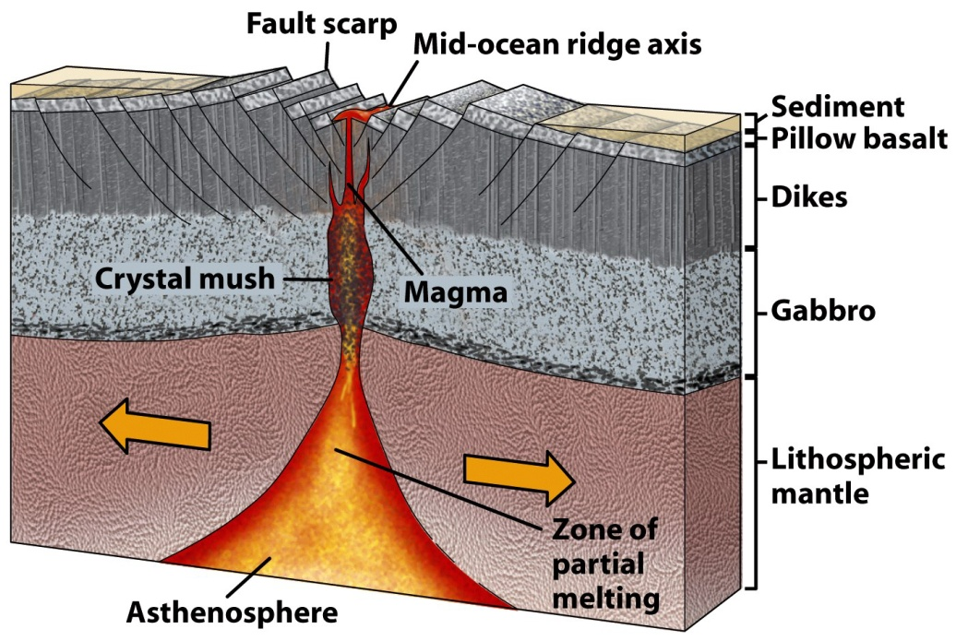
Mid-Ocean Ridges
Magma from the Asthenosphere rises to fill in gap created by sea-floor spreading
Notes:
Magma from the Asthenosphere rises to fill in gap created by sea-floor spreading – dikes are conduits for magma to flow up to surface – lava pools at surface, cools, and is pulled apart.
Some magma solidifies along the side of the chamber, some erupts as lava at the surface

Slide 14
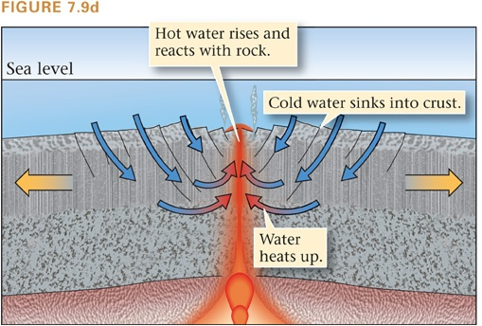
Hydrothermal Alteration

Slide 15
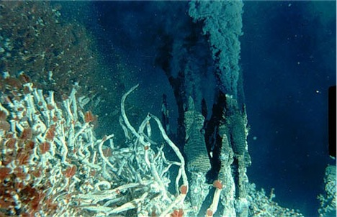
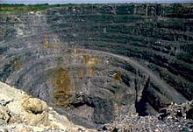
Hydrothermal Vents
rich in dissolved ions
Our first ore deposit!!

Slide 16
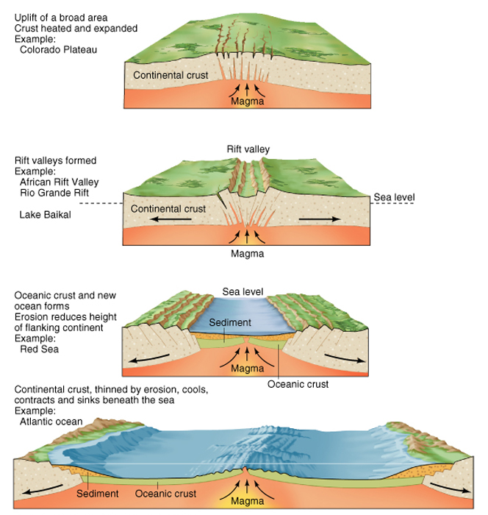
Continental Rifts = birth of a divergent margin

Slide 17
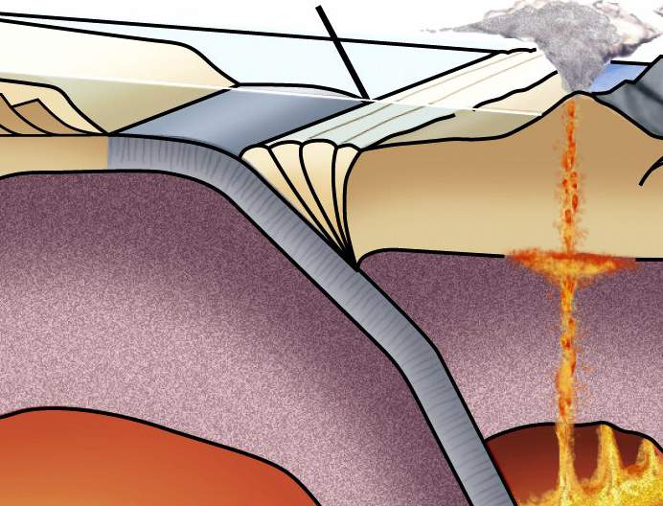
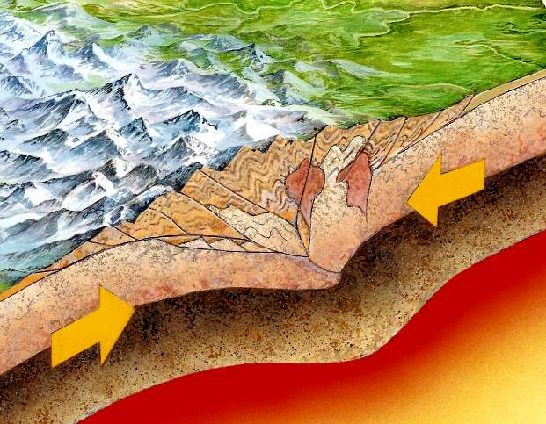
Convergent Plate Boundaries
Plates move toward one another.
Ocean-ocean or
Ocean-continent: Subduction
Continent-continent: Collision
Notes:
We will focus on the ones where one plate is oceanic for now

Slide 18
Subduction Zones
Oceanic plate dives back into the mantle
→ subduction
Recycling of oceanic lithosphere
Balanced by sea-floor spreading
Notes:
The amount of oceanic plate consumption at subduction zones worldwide, averaged over time, is EQUAL to the amount of oceanic crust produced by sea-floor spreading at mid ocean ridges.
Continental lithosphere is too buoyant to subduct. Its like a life preserver. If continental crust moves into a subduction zone, subduction stops.
AGE: this means oldest oceanic crust is only 200 Ma, whereas oldest continental crust is 3.8 Ga, it sticks around.

Slide 19
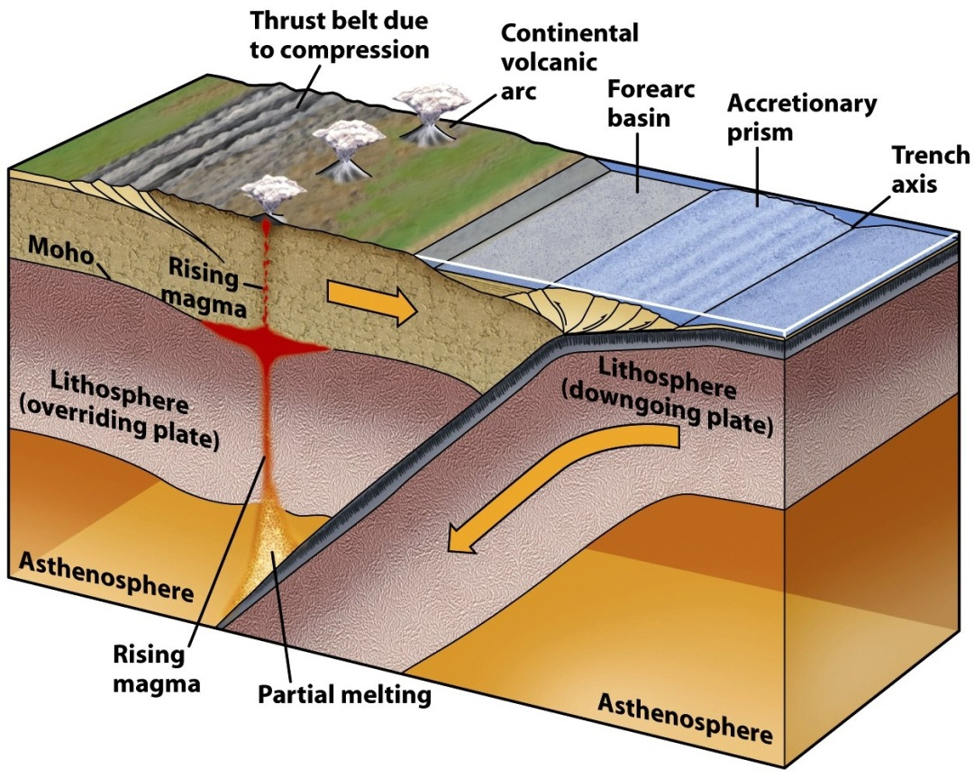
Features of subduction zones
Trench
Accretionary Prism
Volcanic Arcs

Slide 20
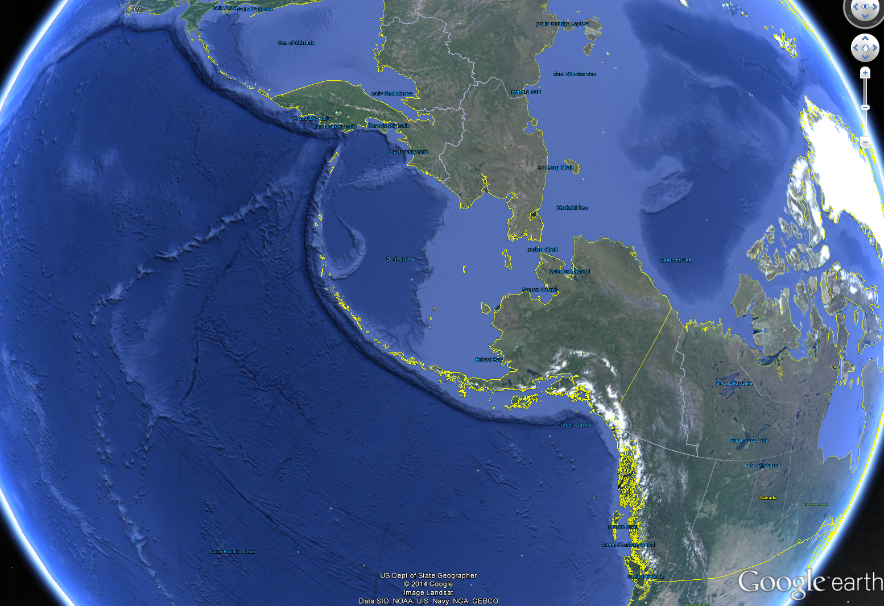

Slide 21
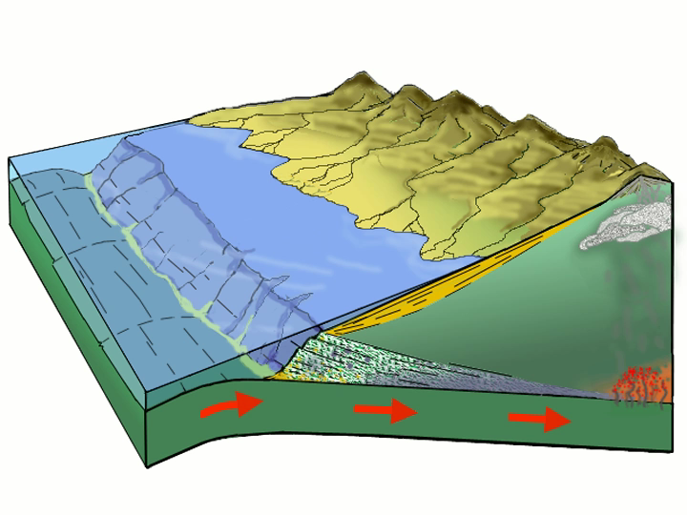
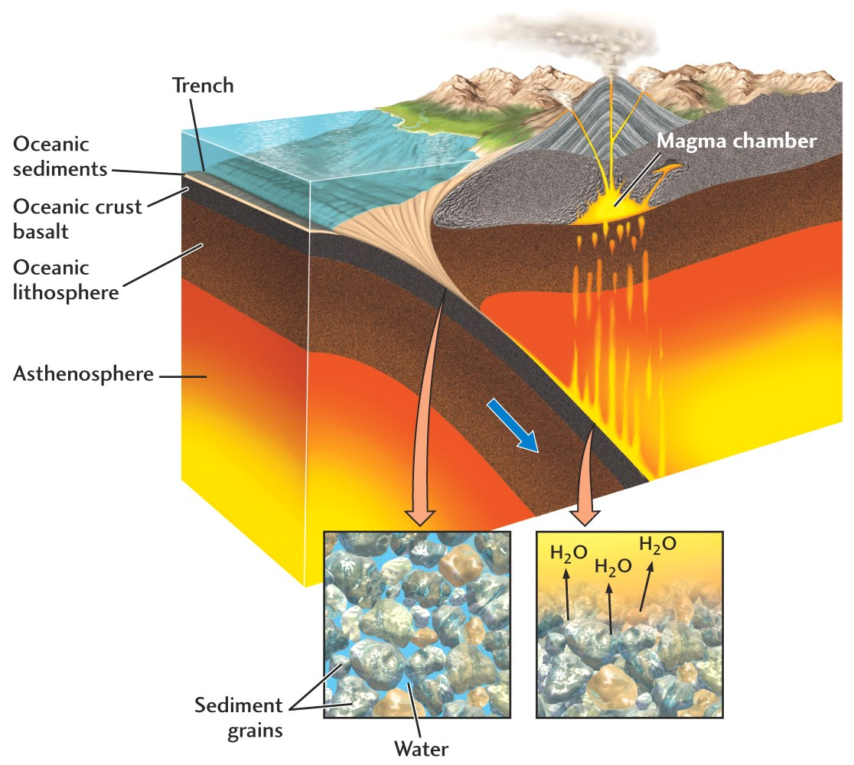
Volcanic Arcs
Oceanic sediments and crust contain water
Slab is “dehydrated” (water is removed)
Water moves into mantle beneath overlying plate
Mantle melts – melts rise to surface and erupt
Porphyry Cu
and Mo deposits
form in volcanic arcs!

Slide 22
Volcanic Arcs
Produce silica-rich (SiO2) rocks →granite/rhyolite
Can form on overlying continental or oceanic plate (depending on boundary)

Slide 23
Notes:
23

Slide 24
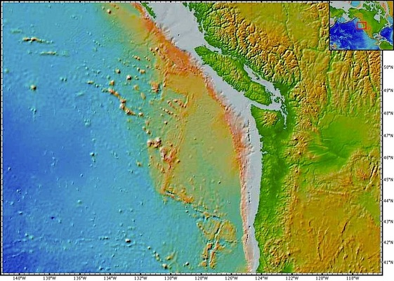
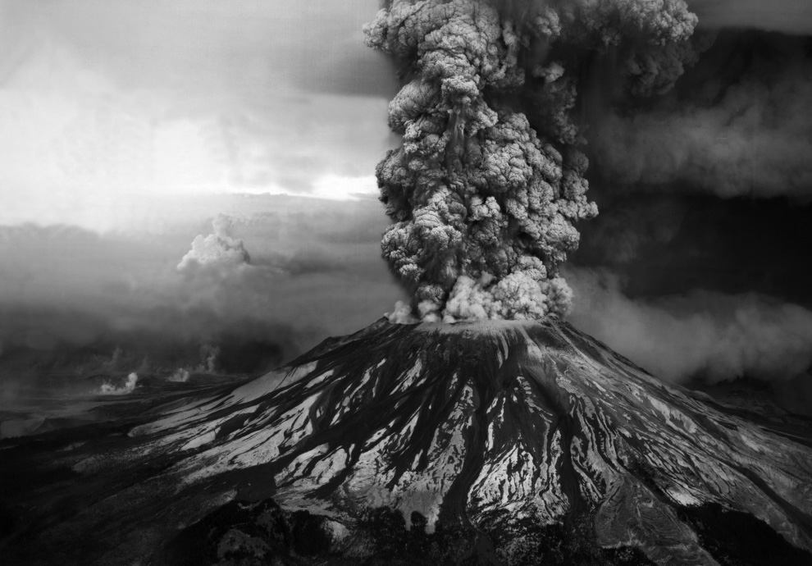
Cascade volcanoes!

Slide 25
Collisional Zones
Continent-Continent Convergence
Why no subduction?
Cont. lithosphere too buoyant to be subducted (much)
Mountain building but no volcanism – why?
no magma generation

Slide 26
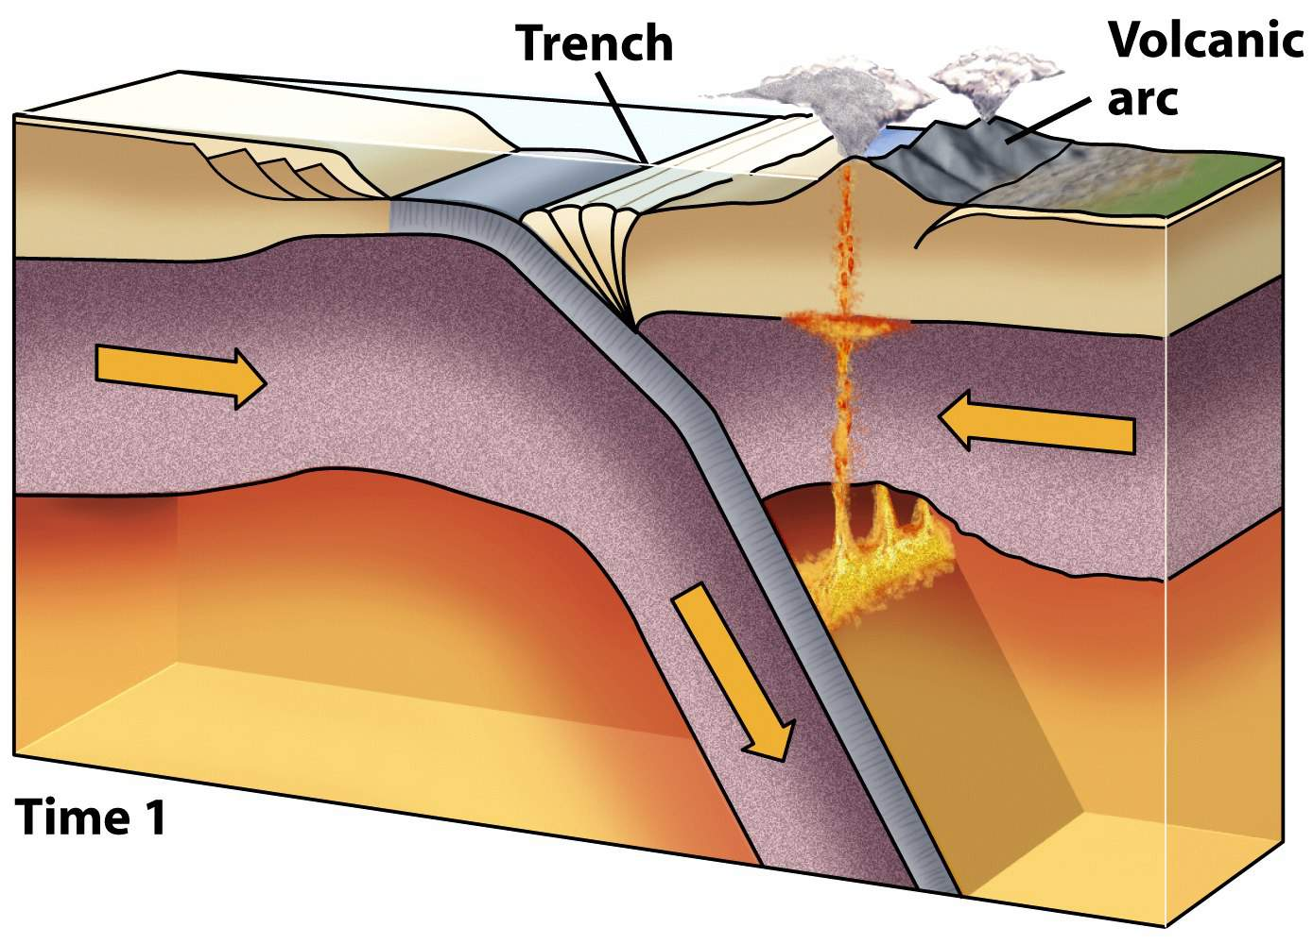
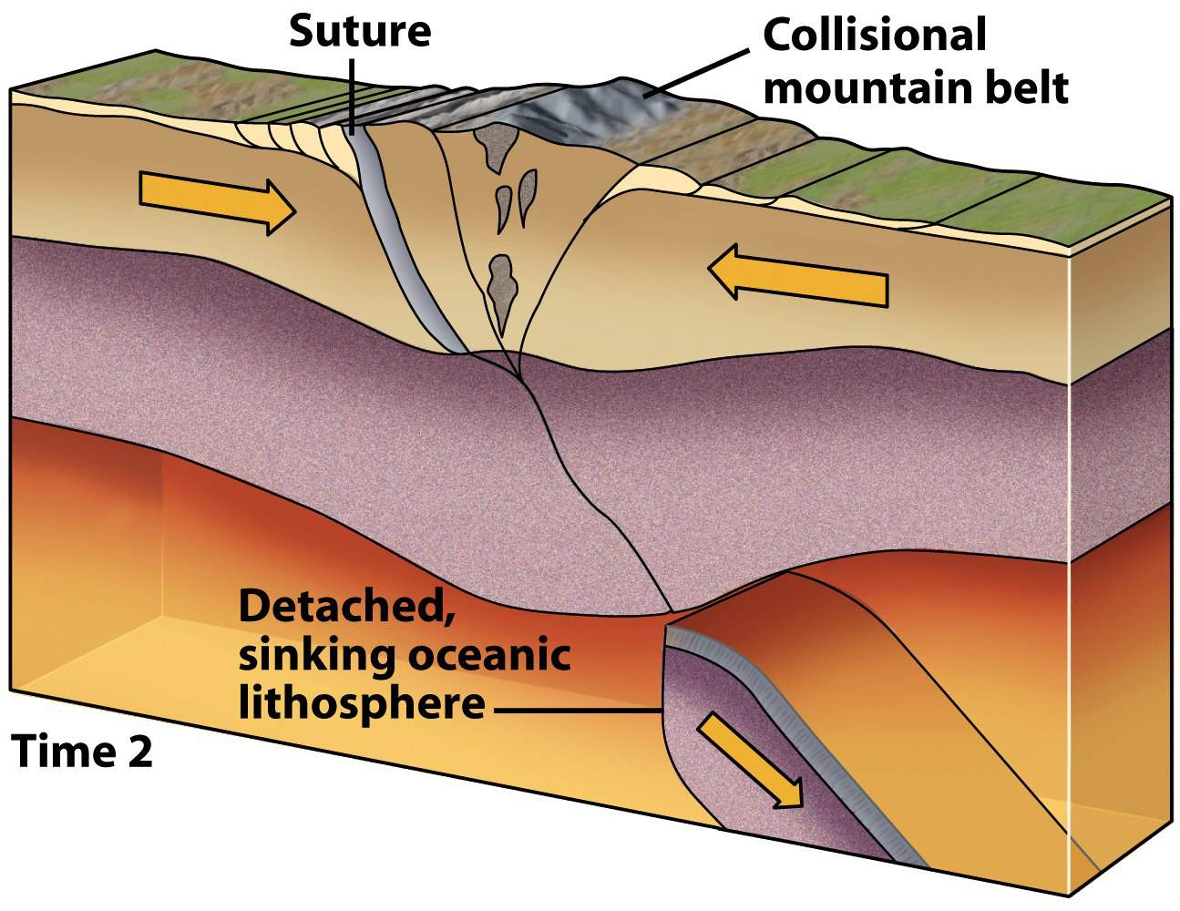
Collisional Zones
Conveyer Belt – subduction zones often evolve into collisions!

Slide 27
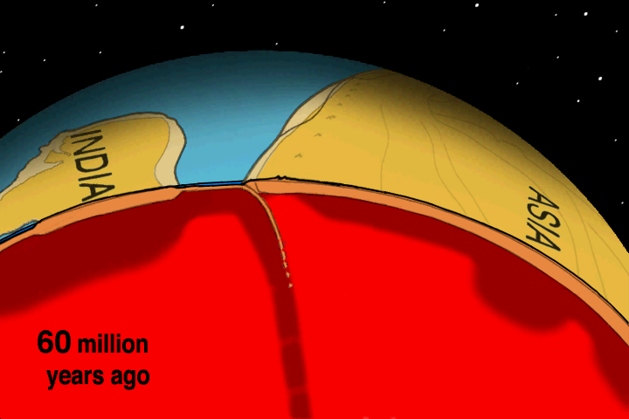
Collisional Zones
Courtesy of Tanya Atwater

Slide 28
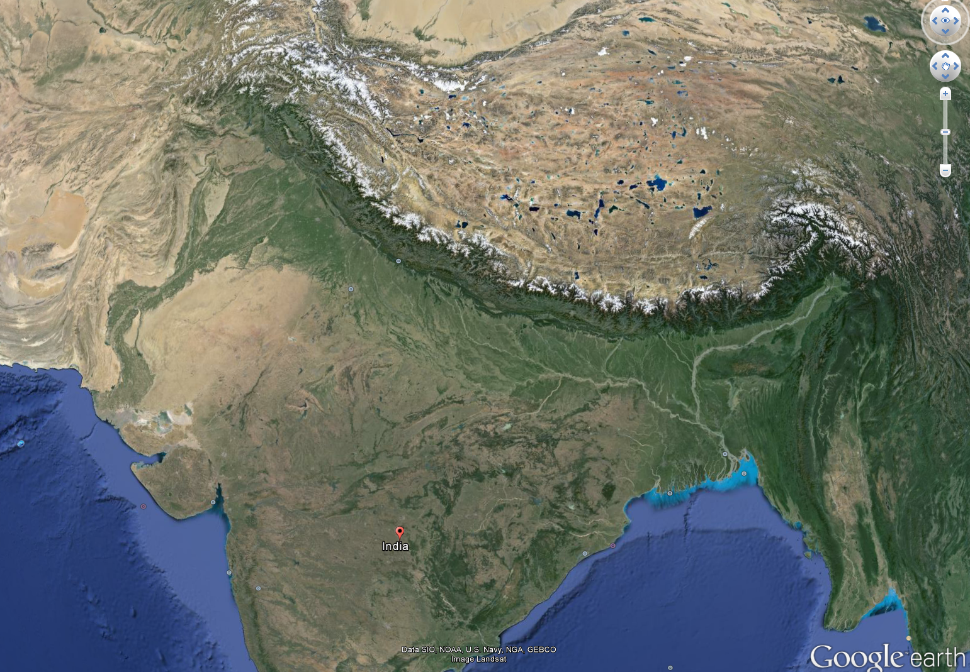
Collisional Zones

Slide 29
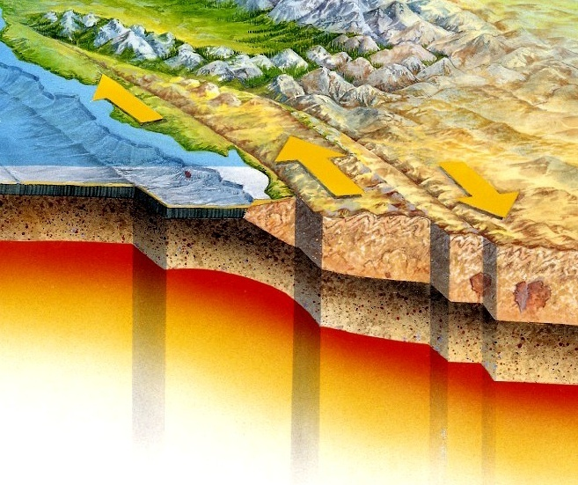
Transform Plate Boundaries
They form a link between two other types of plate boundaries
Plates slide past
No creation/destruction
Continental
Oceanic
Notes:
Draw on board the links?

Slide 30
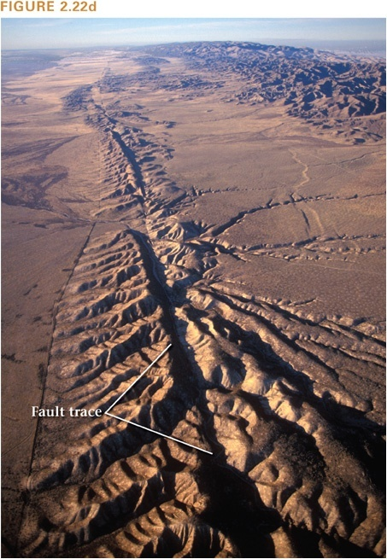
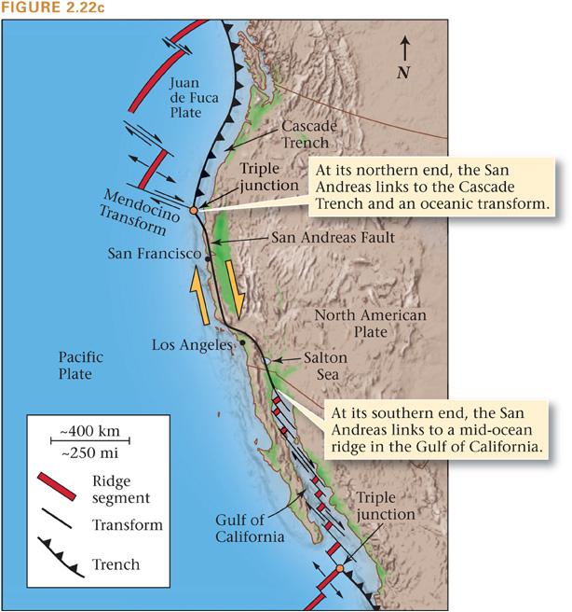
Continental Transforms:
San Andreas Fault, CA

Slide 31
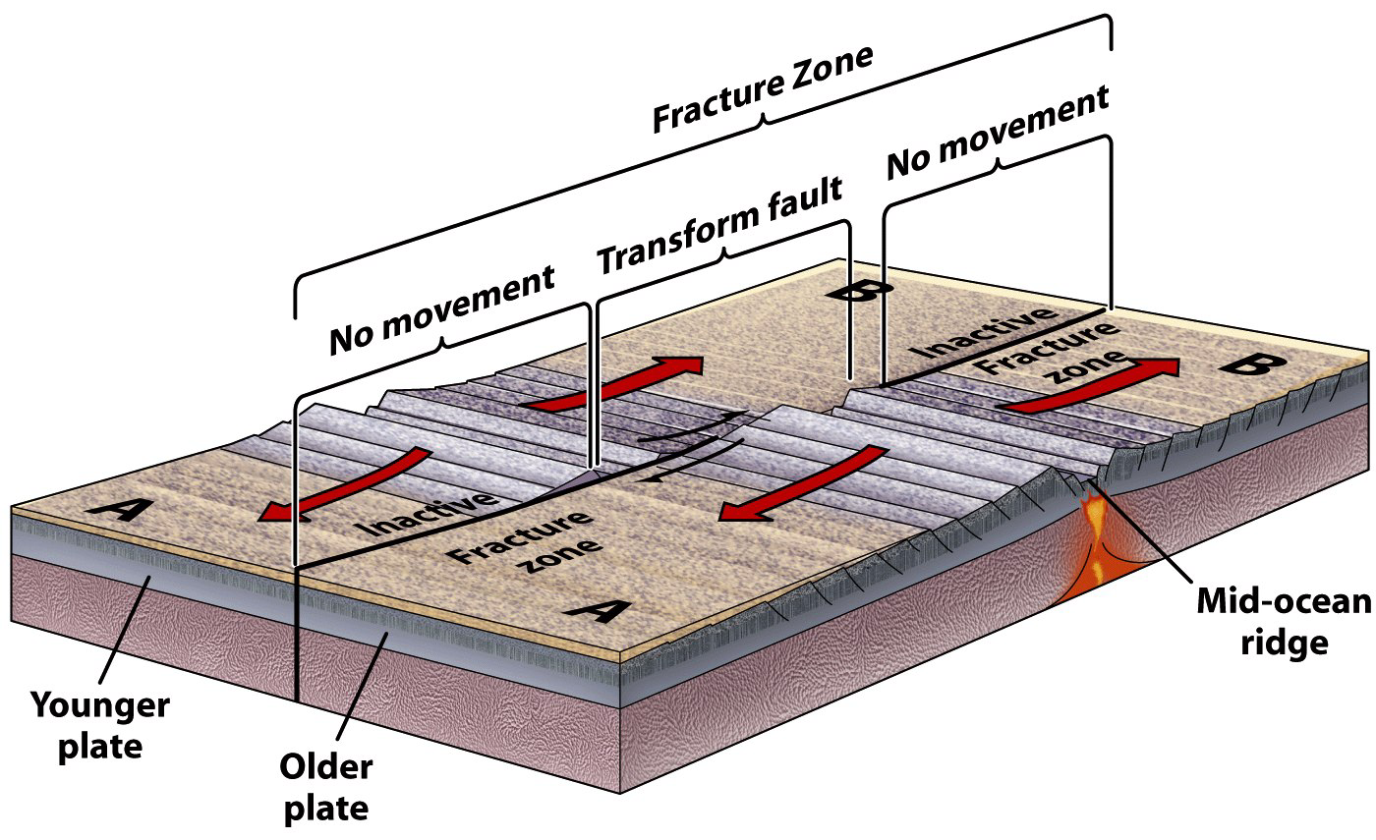
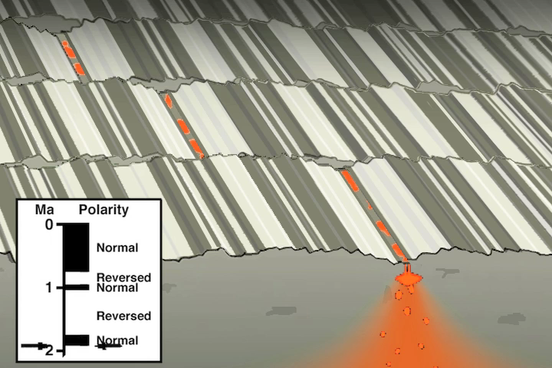
Oceanic Transforms
Courtesy of Tanya Atwater

Slide 32
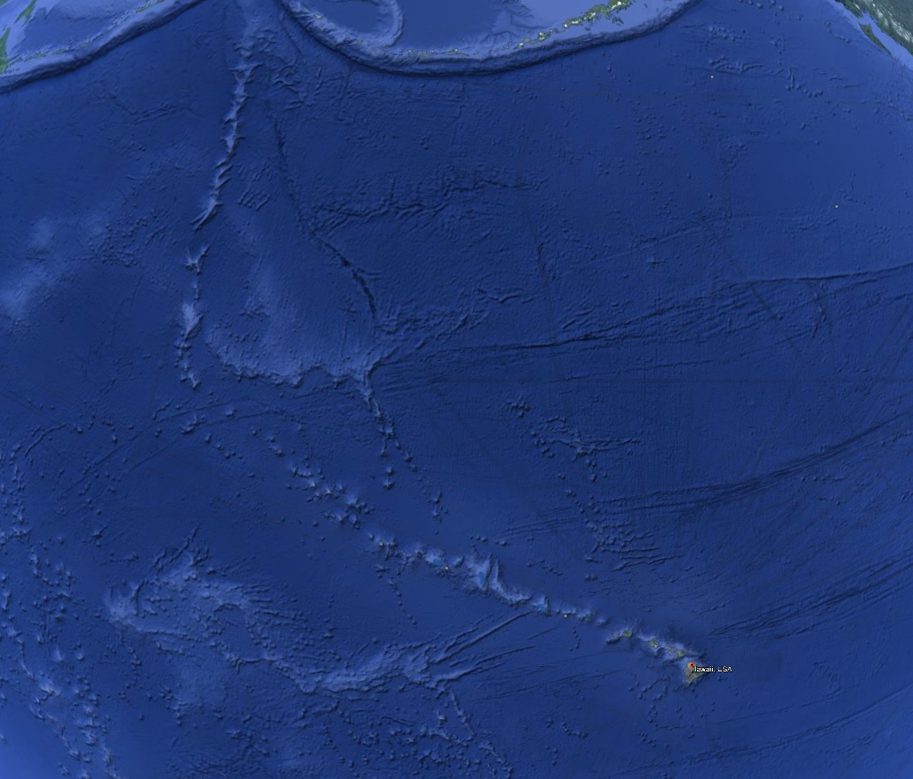
Hot Spots
Volcanoes independent of plates
“intra-plate volcanism”
leave distinct chain of volcanoes

Slide 33
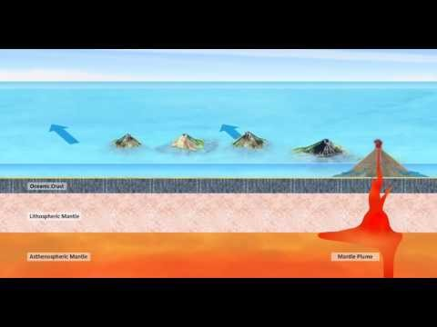
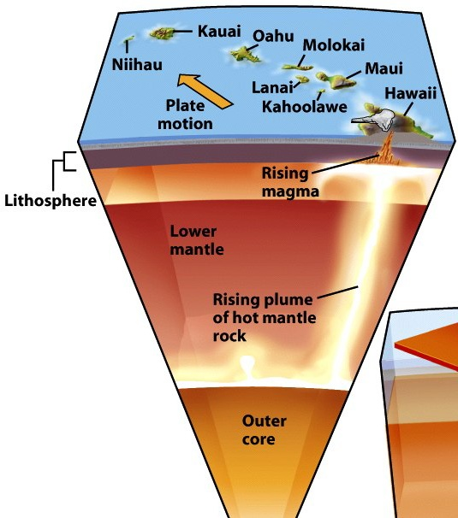
Hot Spots – Mechanism = mantle plume

